Slide 1
MOVIE RECOMMENDATION SYSTEM
su
Under the supervision of
Srinivas Aluvala
Associate Professor School of
Computer Science & Artificial Intelligence
Presented for
Milestone 3-Final Minor Project Review
Date:25-04-2024
Candidate No. & Name
HTNO. | Name
2103A52126 2103A52165 2103A52072 | BIMIREDDY SANJANA AKSHITHA REDDY PAILLA DANDA SREENIJA

Slide 2
Abstract
The ever-growing library of movies can make choosing what to watch overwhelming. This project aims to develop a movie recommendation system that suggests films tailored to individual user preferences. The system will leverage machine learning techniques to analyze user data, such as past watch history and ratings, to identify patterns and correlations.Social media marketing heavily relies on artificial intelligence. It also covers any intelligence demonstrated by a computer, a robot, or any other machine that resembles human intellect. This study examines how artificial intelligence affects Recommendation systems.They employ machine learning and AI to serve users the material that interests them, identify visuals, recommend tag choices, recognise people in photos, and serve adverts to generate user-specific offers and promotions.

Slide 3
Motivation and Background
Motive of our project is by helping users discovers movies that they are likely to enjoy. With the vast amount of movies options available, these systems narrow down choices based on individual preferences, making it easier for users to find content suited to their tastes.
Reduced Decision Fatigue
Discovery of New Films
Increased Enjoyment
Movie recommendation systems are a well-established area of research within the field of recommender systems. These systems utilize various techniques, including:
Collaborative Filtering
Content-Based Filtering
Hybrid Approaches

Slide 4
Introduction
In the vast ocean of cinema, finding the perfect movie to watch can feel like searching for a hidden treasure. We all have our favorite genres, directors, and actors, but sometimes we crave something new or simply can't decide. This is where movie recommendation systems come in, acting as personal guides to cinematic discovery.Machine learning has a subclass known as recommendation engines that often rankor rate people or items. A recommender system, broadly defined, is a system that anticipates the ratings a user would give to a certain item. These predictions will then be ranked and returned back to the user. They’re used by various large namecompanies like Google, Instagram, Spotify, Amazon, Reddit, Netflix etc. often to increase engagement with users and the platform.

Slide 5
Objective
Understanding user preferences: The system should learn from user interactions to generate personalized recommendations.
Providing relevant suggestions: The recommended movies should align with the user's taste in genres, directors, actors, and other movie attributes.
Enhancing user experience: The system should make it easier for users to discover new movies they'll enjoy, ultimately increasing satisfaction with the platform.
The primary objective of this project is to develop a robust movie recommendation system that personalizes movie suggestions for each user.

Slide 6
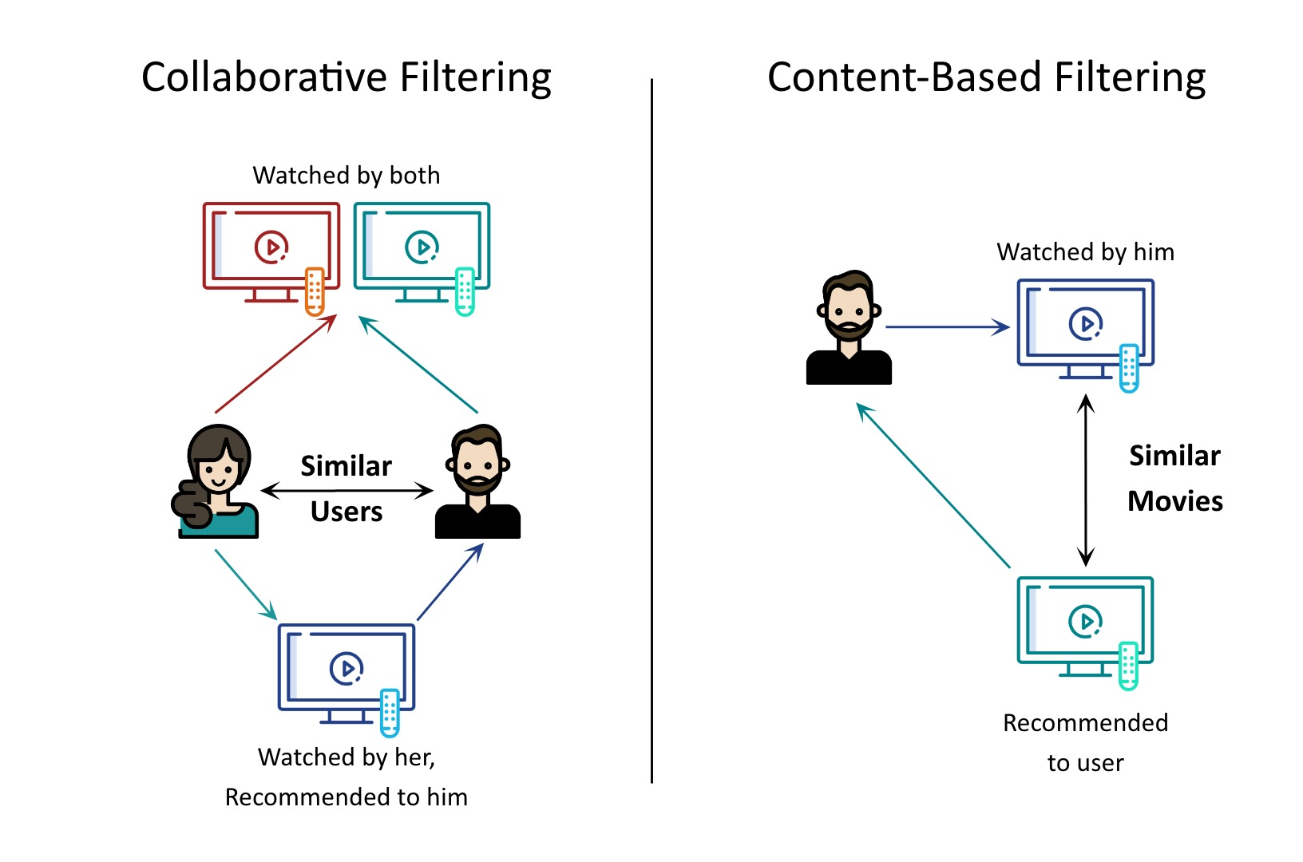
Collaborative Filtering
The collaborative filtering method is based on gathering and analyzing data on user’s behavior. This includes the user’s online activities and predicting what theywill like based on the similarity with other users

Slide 7
Content-Based Filtering
Content based filtering is based on collecting and examining user behaviour data.This includes anticipating what the user will like based on similarities to other users and the user's online activities.

Slide 8
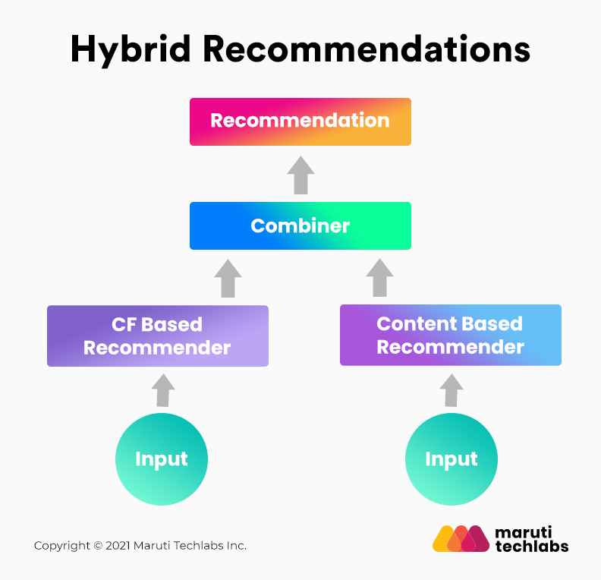
Hybrid Recommendation Systems
To provide clients a wider selection of items, hybrid recommendation systems promote products using both content-based and collaborative filtering concurrently. It is claimed that this emerging recommendation system makes recommendationsthat are more accurate than those made by other recommender systems.

Slide 9
Literature Review
Author& Year | Model Used | Merits | Limitations | Drawbacks | Dataset Used
Caesar Jude (2019) | Matrix Factorization | Enhanced user experience | Sparsity issue | Limited scalability | MovieLens dataset
Nguyen et al. (2020) | Reinforcement Learning | Adaptive to user preferences | Exploration-exploitation trade-off | Instability during training | Ta-Feng dataset
Kim et al. (2021) | Attention Mechanism | Captures user attention patterns | Computational overhead | Interpretability challenges | Criteo dataset
Laxmi Shanker maurya (2021) | Context-Aware Recommender Systems | Considers contextual information | Data sparsity in context | Complexity in context modeling | Last.fm dataset
Krishnanshu Agarwal (2021) | Ensemble Methods | Aggregates multiple recommendation algorithms | Increased computational complexity | Difficulty in model interpretation | MovieLens dataset

Slide 10
Existing System
Netflix
Amazon Prime
MovieLens
Tubi
many streaming services
Hulu
Disney+hotstar
YouTube
IMDb
Google

Slide 11
Disadvantages
Cold Start Problem: It needs enough users in the system to find a match. For instance, if we want to find similar user or similar item, we match them with the set of available users or items.
Data Sparsity: The user or rating matrix is very sparse. It is very hard to find users that have rated the same items because most of the user does not rate the items
Scalability:Collaborative Filtering use massive amount of data to make reliable better which require more number of resources.
Data Bias and Fairness: Recommendation algorithms can perpetuate biases present in the data they are trained on.
Privacy Concerns: Collecting and utilizing user data for recommendations raises privacy concerns.

Slide 12
Methodology
Social media marketing
Recommendation system
Using social media marketing the company or organization expands their business. Marketing helps business people via social media like they recommend their ads in certain social media sites like FB,YT,IG . In this we used social media marketing like recommendation systems methods that help to improve the market via social media according to the customer browsing what he searches in google then that type of recommendations show in other social media sites.
We used methods of recommendation like content based ,popularity based , collaborative based , to recommend according to customer past browsing data.This recommendation systems recommends the movies based on the watching pattern of individuals based on some previous data it has collected from the other individuals

Slide 13
Methodology
Content based recommendation
Popularity based recommendation
we are using popular recommendation because popularity based recommendation system so this kind of system recommends which movie or series has been very popular so in netflix there is an uh you know column called as top 10 movies in india and the top 10 movies of ultimate such kind of things so it is completely based on popularity and the popularity you know basically and the popularity you know basically increases if more number of people watches those kind of films okay so that is the popularity based recommendation system which mainly relies on what is the popularity of films and what is the popularity of the actors acted in the movie directors
We used content recommendations to recommend movies according to the customer's previous downloading movies by usage of python and some other softwares . content-based recommendation system will mainly recommend recommend them you know space related movies and so on so this system is completely based on the content of the movie and its story and so on

Slide 14
Gap Identification
Data Sparsity and Cold Start Problems:
Collaborative filtering can struggle with new users due to a lack of data on their preferences.
Content-based filtering might not capture the full complexity of user preferences, leading to generic recommendations.
Explainability and Transparency:
Users often lack insight into how the system generates recommendations.
Modeling User Dynamics and Evolving Preferences:
User preferences can change over time. Existing systems might not effectively capture these evolving preferences.
Addressing Bias and Fairness:
Recommendation algorithms can perpetuate biases present in the data, favoring certain genres, actors, or directors

Slide 15
Problem Identification
Manual Data Entry
Privacy and security concerns
Data Privacy Concerns
Explainability and Transparency
Scalability and Real-time Updates
Cold Item Problem
Accuracy and Overspecialization
Data Sparsity and Cold Start Problem

Slide 16
Proposed Methodology
Data Collection and Preprocessing
Feature Engineering
Model Selection and Training
Recommendation Generation
Evaluation and Refinement
Deployment and User Interface
Continuous Improvement

Slide 17
Algorithm Explanation
Excel
we used excel file for using of data sets of movies which the movies insert in the file according to their genres, titles, cast, crew , director etc; and customer data sets which movies are downloaded
Pandas
To import data sets we are using pandas because pandas is python library Python library for data analysis. It is a powerful and flexible quantitative analysis tool, pandas has grown into one of the most popular Python libraries
Numpy
To get numericals in this research work we used numpy python library .NumPy is a Python library used for working with arrays. It also has functions for working in the domain of linear algebra, fourier transform, and matrices.
Data collection
We need to have the data of these movies and several details about them like director name,genres,description. Once we collect the data we need to perform this data

Slide 18
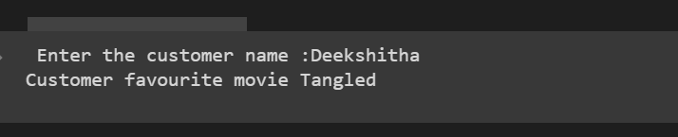
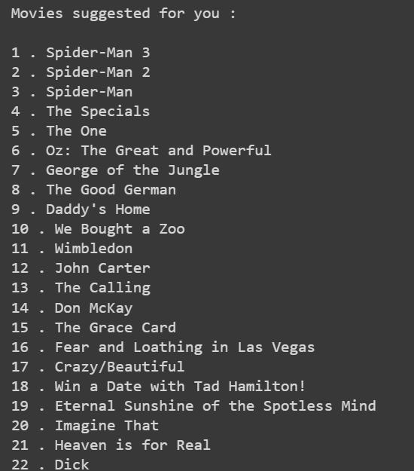
Result

Slide 19
Conclusion
In this project we have taken movie dataset from the internet.And we have created customers dataset, including their downloaded movies.Based on our code the recommended movie as shown via with recommended methods. A movie recommender system is a machine learning algorithm that predicts the likelihood of a user’s preference for a particular movie based on their previous behavior, such as movie ratings, watch history, and browsing history.

